Slide 1

Adaptive Traffic Control System
- By Group 24
PROJECT EXHIBITION – II (2022-23)

Slide 2
Team and Faculty
Faculty Supervisor - Dr. Hariharan R
Faculty Reviewer – Dr. Ashish Mohan Yadav
Team members:
Rajat Kabra – 21BSA10069
Aditya Bharadwaj – 21BSA10022
Prateek Sonkar – 21BSA10033
Siddharth Tyagi – 21BSA10071
Anshul Malik – 21BSA10089

Slide 3
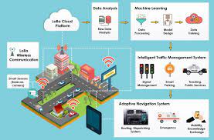
Introduction
Traffic congestion is a major problem in many cities, and the fixed-cycle light signal controllers are not resolving the high waiting time in the intersection.
While at signal often a policeman is seen managing the movements instead of the traffic light.
The control system sees road status and decides the allowed duration of each direction.
This human achievement encourages us to create a smart Traffic light control considering the real time traffic condition and smartly manage the intersection.

Slide 4

Uses of Smart Traffic Light Management System

Slide 5
Adaptive Traffic Control System
2.
To implement such a system, we need two main parts:
Eyes to watch the real-time road condition
1.
Brain to process it.
REQUIRE
TASK 1
Move as many users through the intersection as possible doing this with as little conflict between these users as possible.
TASK 2
Video is a powerful medium for conveying information and data is plentiful wherever there are cameras.
A traffic signal system at its core has two major tasks:
Faculty Supervisor = Dr. Hariharan
Mission Description
Notes:
© Copyright PresentationGO.com – The free PowerPoint and Google Slides template library

Slide 6
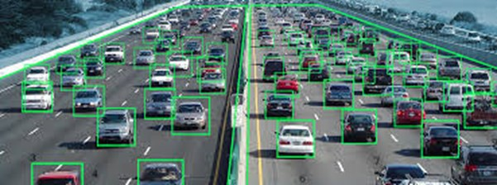
Traffic Vision
Traffic is one of the major problems in all developing countries. As development is being done and the economy is pumped with money, the number of vehicle owners is skyrocketing. It's getting difficult for authorities to manage traffic despite thumping efforts of government.

Slide 7
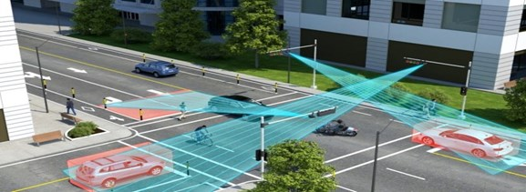
Traffic Control System
Government is trying its best to ensure swift movement of traffic on roads by constructing wider roads, flyovers, underpasses and expressways etc. But, giving wider roads to the burgeoning number of vehicles is not enough. You must ensure safety on roads along with traffic management and it can better be achieved by Traffic Control System (TCS).

Slide 8
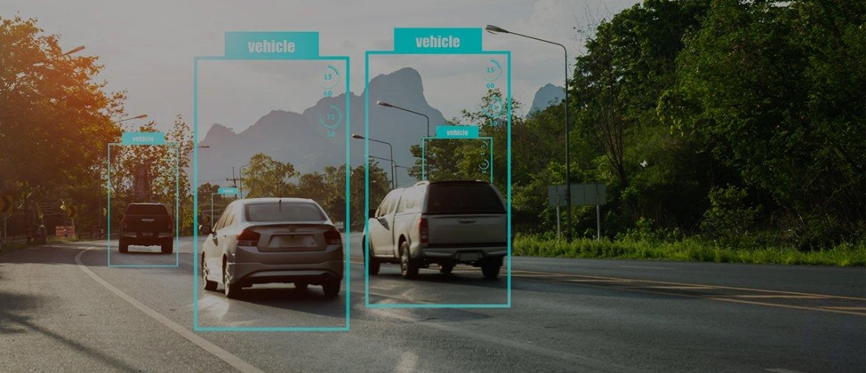
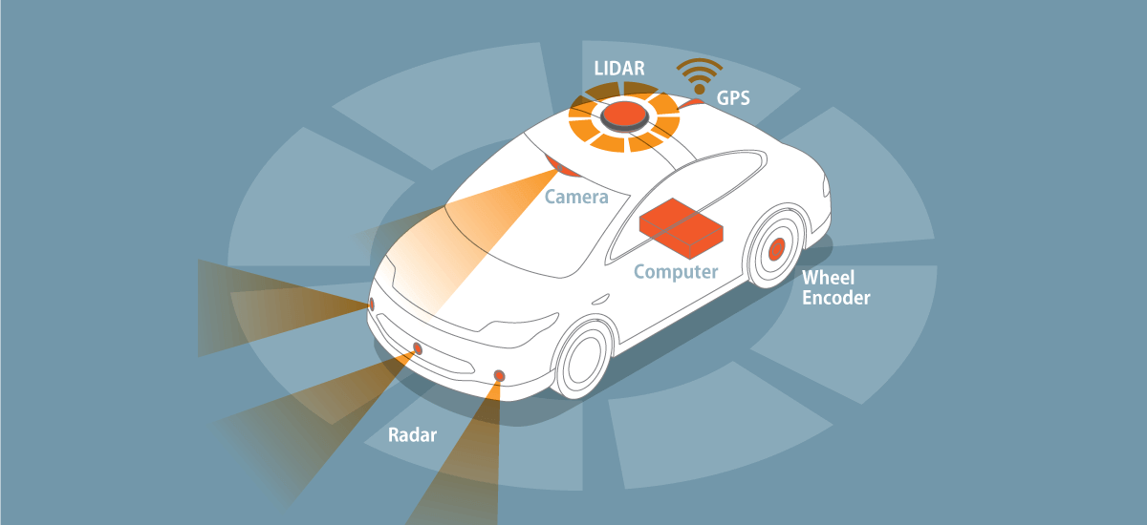
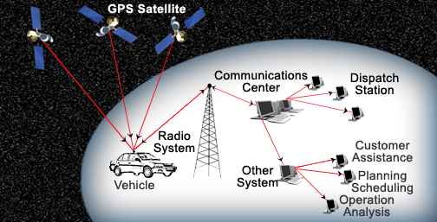
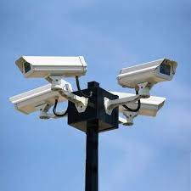
Data Collection
Hardware devices are installed to collect data from different sources. This hardware includes automatic vehicle identifiers, sensors, camera, and GPS based automatic vehicle locators etc. The received data such as traffic count, travel speed, vehicle weight, surveillance, and delays etc. is forwarded to the master controller.

Slide 9
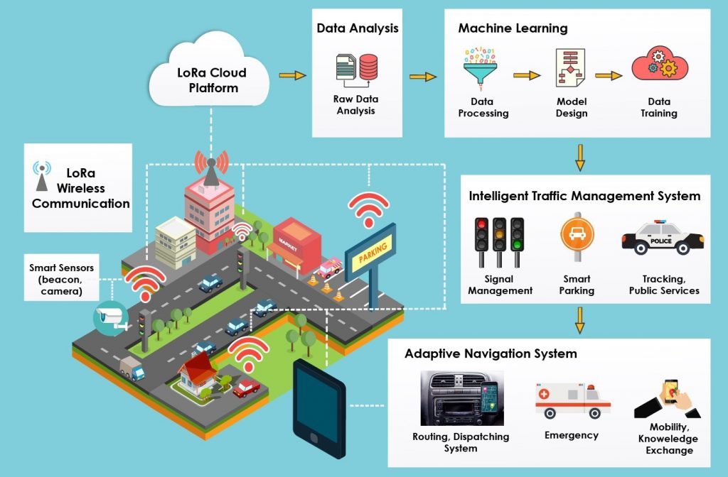
Data analysis
The massive amount of data collected is then processed in few steps such as error rectification, data synthesis, data cleaning, and adaptive logical analysis. This data is also used to predict the traffic scenario in future.

Slide 10
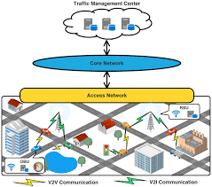
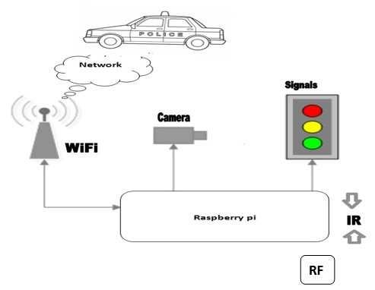
Existing Work with Limitations
To build a self-adaptive traffic light control system based on yolo.
Disproportionate and diverse traffic in different lanes leads to inefficient utilization of same time slot for each of them characterized by slower speeds, longer trip times, and increased vehicular queuing.
To create a system which enable the traffic management system to take time allocation decisions for a particular lane according to the traffic density on other different lanes with the help of cameras, image processing modules.

Slide 11
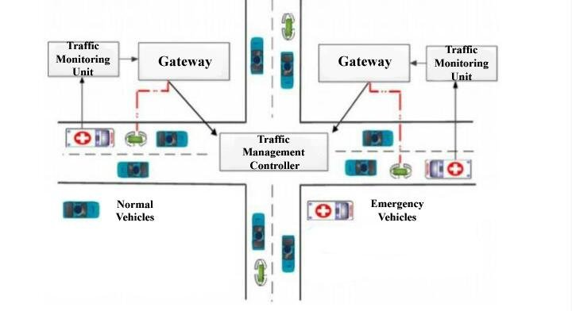
Proposed Work
This model works on the principle of changing time delay of traffic signals based on the number of vehicles passing through the assigned section of the road.
Instead of using fixed time delay for each lane, we are using magnetic loop vehicle detection sensor on each lane of the junction. Whenever there is presence of vehicle in the particular loop, the sensor will detect the metal and sends information to microcontroller.

Slide 12
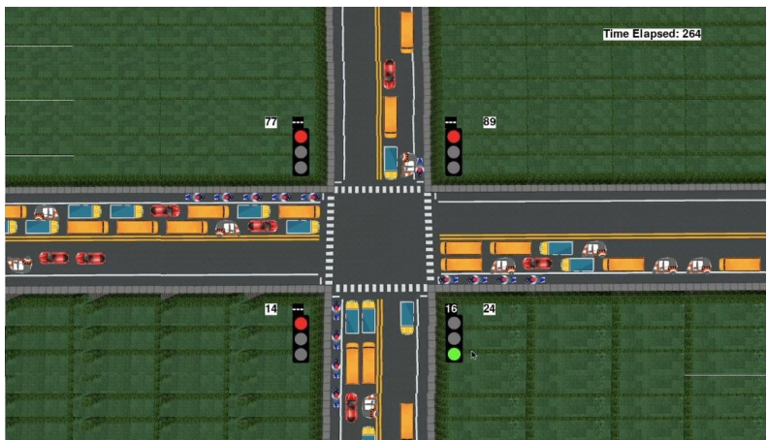
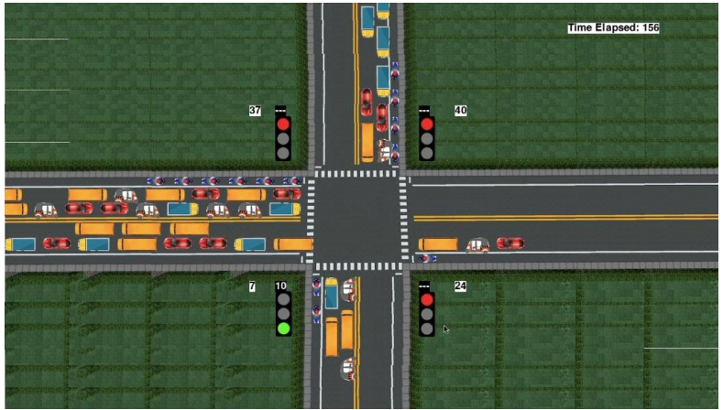
Proposed Work
There are six cases according to which the system will work:
The first case is considered as the best case where all the 4 lanes have high density. In such case every lane will be provided with equal time.
The second case states that the density of opposite lane is higher. Here due to the low density of 2 lanes the time which was not used by the lower density lane’s will be added to the lanes with high density.
The third case has a single lane with high density and other 3 lanes with low density.

Slide 13
Proposed Work
The fourth case consist of consecutive high and consecutive low density. Here in the loop, the unoccupied time of previous lane will be added to the next lane having high density.
The fifth case consist of consecutive low density.
Similar to the fourth case the unoccupied time of previous lane will be added to the next lane which having high density.

Slide 14
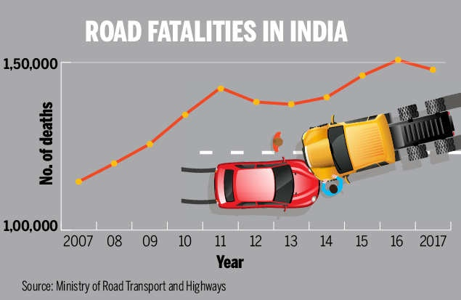
Novelty Of The Project
In our country, breaking rules and regulation is a very common habit of the drivers. This causes a lot of accident. As an estimate says every year, approximately 1.5 lakh people dies on India roads, which translate, on an average, into 1130 accidents and 422 deaths every day or 47 accidents and 18 deaths every hour.
So solving this issue, the proposed project with the advanced technology that will help traffic police in their work. Adaptive Traffic Control System once installed on a signal does not require any human interference.

Slide 15
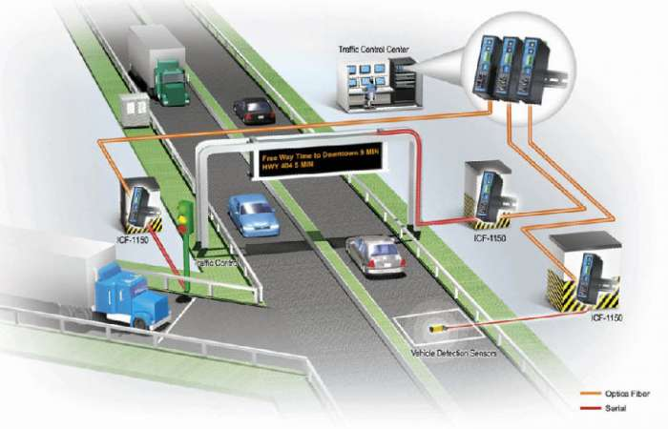
Real Time Usage
1. The system proposed to be used in road traffic signals.
2. Can be enhanced to be used for 5 way and 8 way road junctions.

Slide 16
Requirements
Software
Requirements
Windows 8 or above
SQL
Visual Studio 2008 or above
Processor – i3
Hard Disk – 5GB
Memory – 1GB Ram
Hardware
Requirements

Slide 17



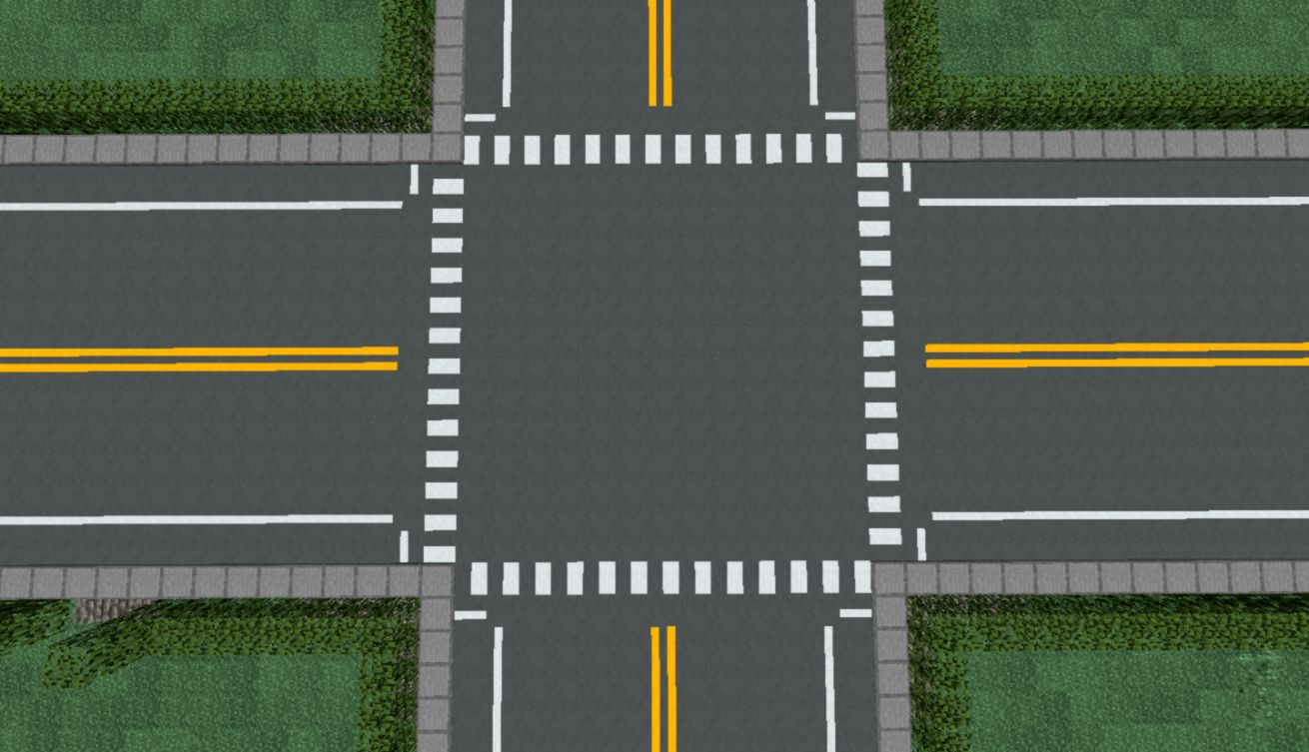
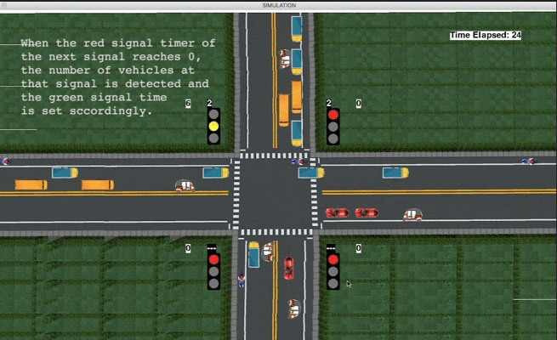
Overall System Architecture Diagram
To show our virtual system architecture:

Slide 18
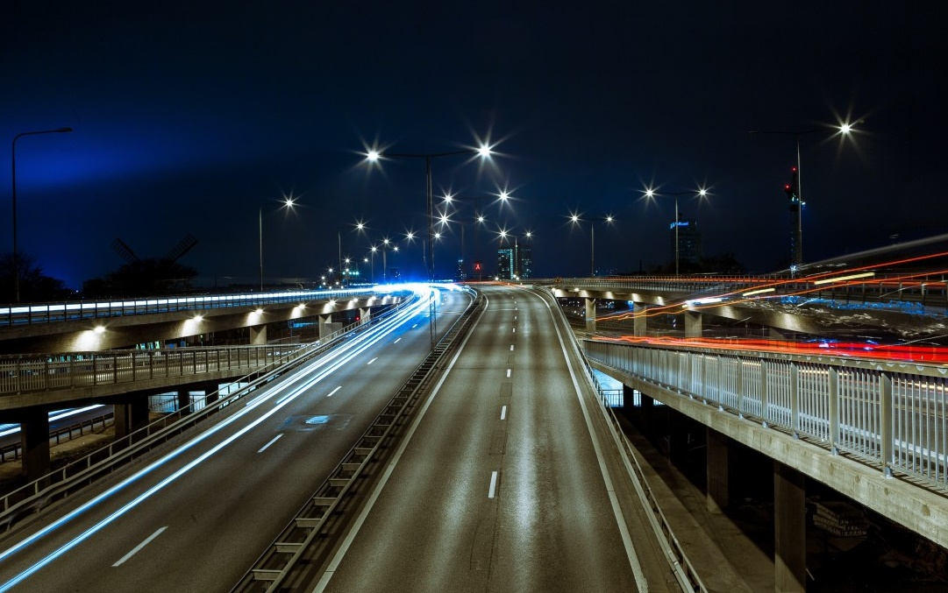
Literature Review
In survey of current methods, it has been noted that traffic management systems (TMS) using wireless sensor networks (WSNs) are becoming popular as they help to avoid congestion, ensure priority for emergency vehicles and reduce the average waiting time (AWT) of vehicles at intersections .
WSNs, RFIDs, ZigBee, VANETs, Bluetooth devices, cameras and infrared signals are increasingly being researched.
The article by Subramaniam et al. A good traffic management system should have the outcomes of increased efficiency of the transportation system, increased mobility and safety and reduced fuel consumption and environmental cost.

Slide 19
Literature Review
To achieve them, the following things need to be facilitated:
Adaptability to current traffic conditions; response for a target and adjacent intersections
The system needs to update signal plans frequently and the operations need to be entirely on-line.
The system needs to update signal plans frequently and the operations need to be entirely on-line.
These outcomes also will increase economic productivity and can be used for a traffic management system using Futuristic Internet of Things.
Intelligent transport control systems must be capable of handling traffic jams, ensure the minimum needed wait time and patience among drivers and provide traffic information to the users.
The design features should be appropriate to achieve these goals.

Slide 20
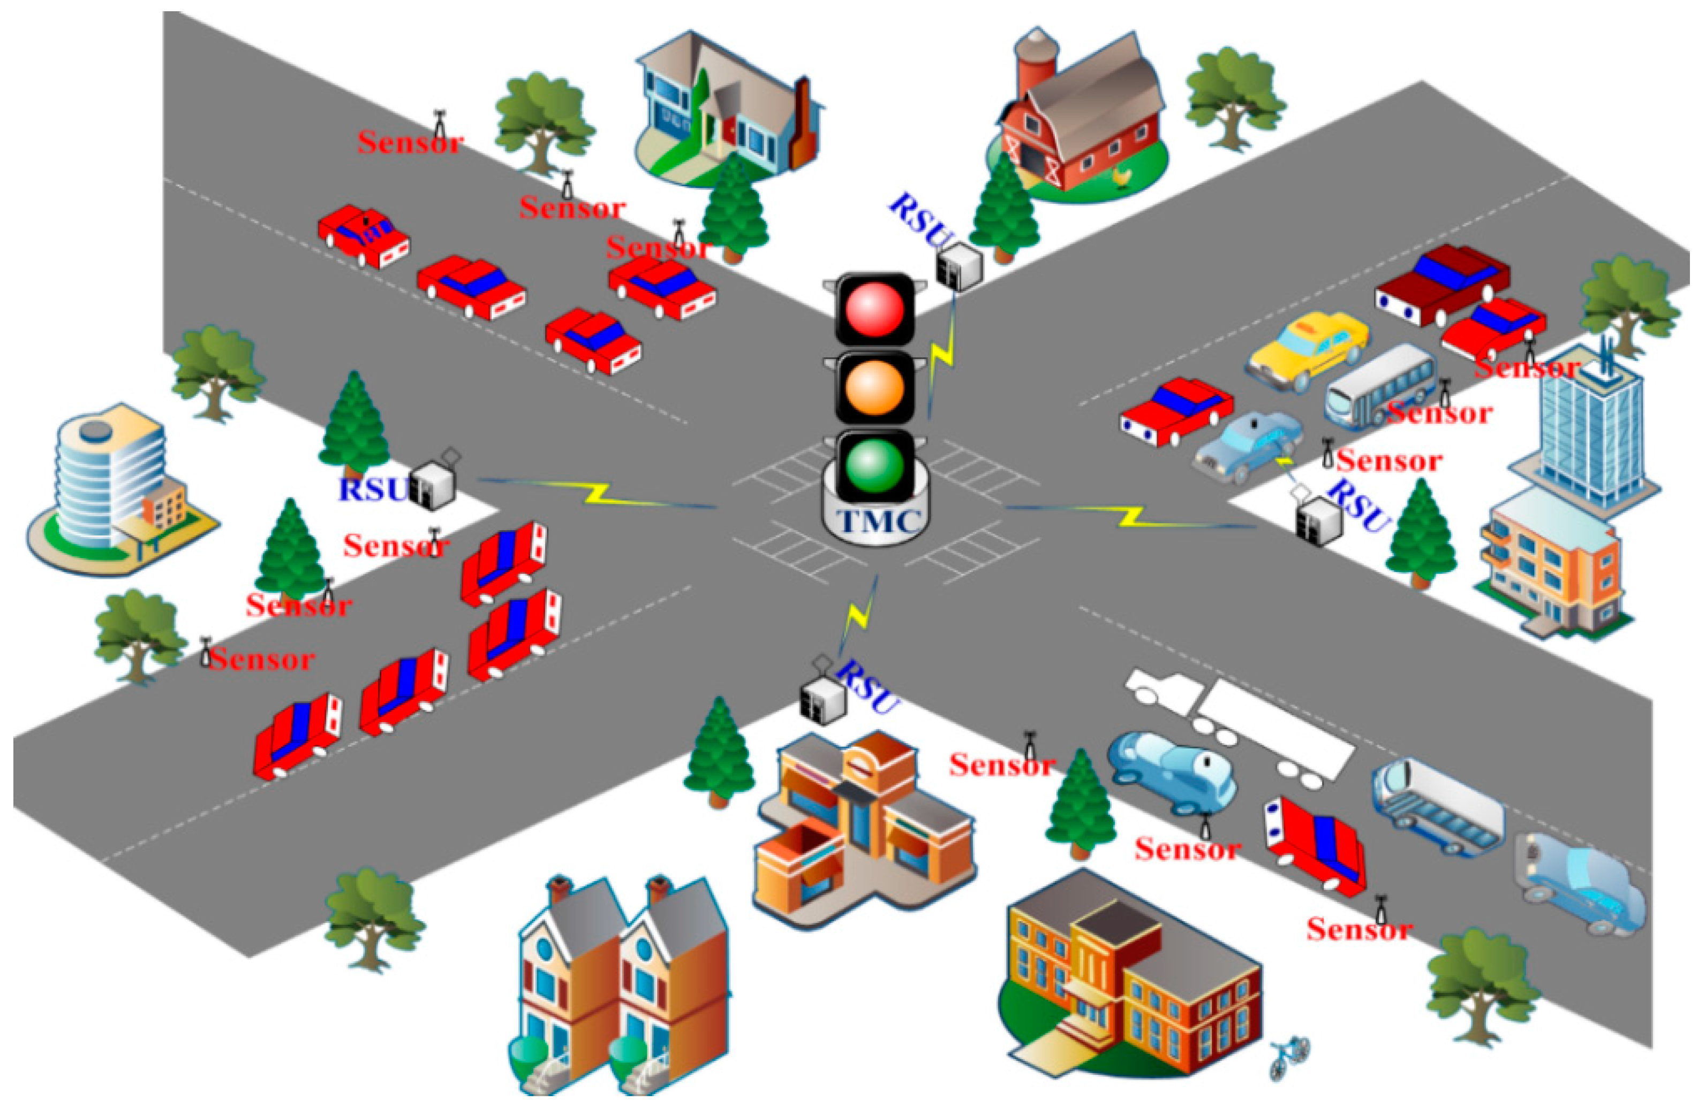
Literature Review
Figure 1: WSN-based urban transport management system (Nellore & Hancke, 2016)

Slide 21
Modules Description
Traffic Density Module: This module consists of hardware such as sensor which will be used to detect traffic density (Presence of vehicle). The sensor forwards that information to microcontroller.
Connectivity Module: This module works as a interface between hardware module and software that is microcontroller and web application. The output from the microcontroller will be considered as input to this connectivity module.
Web Application Module: In this module, admin will login to web portal. The web application will be used for continuously monitoring the status of the system which means it will show which lane at the junction having the high traffic density.

Slide 22
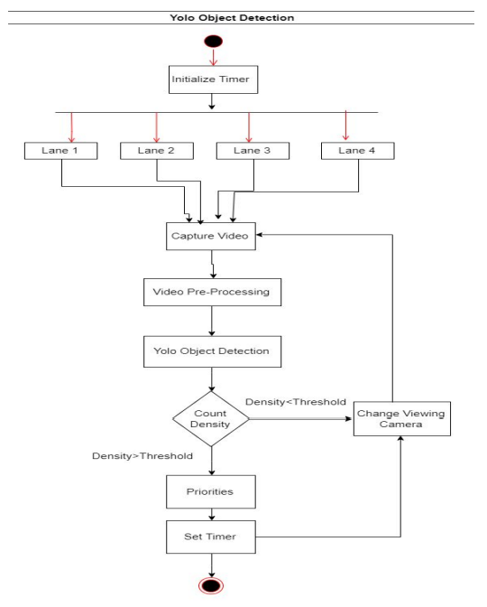
Module Workflow Explanation

Slide 23
Coding And Implementation
Coding And Implementation
The following factors were considered while developing the algorithm:
The processing time of the algorithm to calculate traffic density and then the green light duration – this decides at what time the image needs to be acquired
Number of lanes
Total count of vehicles of each class like cars, trucks, motorcycles, etc.
Traffic density calculated using the above factors
Time added due to lag each vehicle suffers during start-up and the non-linear increase in lag suffered by the vehicles which are at the back.
The average speed of each class of vehicle when the green light starts i.e. the average time required to cross the signal by each class of vehicle
The minimum and maximum time limit for the green light duration - to prevent starvation

Slide 24
Demo Video
For demo video please go to demo.gif

Slide 25
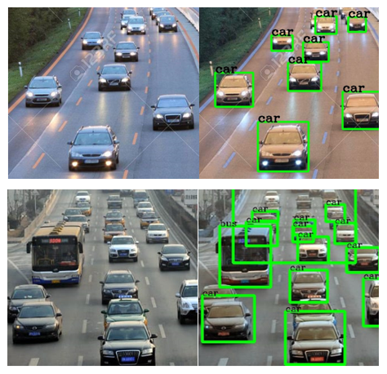
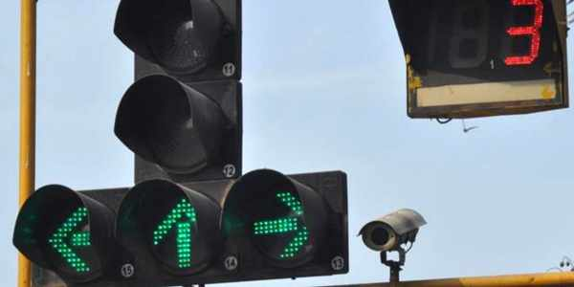
Snapshots

Slide 26
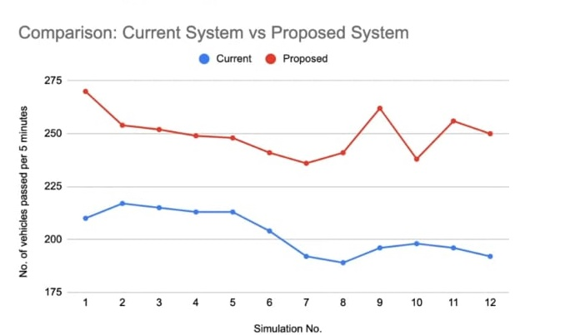
Result and Discussion
The Proposed System:
Lane-wise Vehicle Counts
Lane 1 : 131
Lane 2 : 94
Lane 3 : 28
Lane 4 : 35
Total vehicles passed: 288
Total time passed: 300
No. of vehicles passed per unit time: 0.96

Slide 27
Result and Discussion
As we can see, with all conditions alike, the adaptive system was able to pass 288 vehicles while the current static system could pass only 220 vehicles in 300 seconds, which means 68 more vehicles.
Thus, the proposed adaptive system improves the performance by over 23%.
The adaptive system on an average allows 68 more vehicles to pass every 5 minutes as compared to the static system. This implies a reduction in idle green signal time (signal is green but no vehicle passes) as well as the waiting time of the vehicles.

Slide 28
Principle of Project
Camera sends images after regular short intervals to our system.
The system determines further the number of cars in the lane and hence computes its relative density with respect to other lanes.
Time allotment module takes input (as traffic density) from this system and determines an optimized and efficient time slot.
This value is then triggered by the microprocessor to the respective Traffic Lights.

Slide 29
Conclusion
Thus, the proposed system sets the green signal time adaptively according to the traffic density at the signal and ensures that the direction with more traffic is allotted a green signal for longer duration of time as compared to the direction with lesser traffic.
This will lower the unwanted delays, and reduce congestion and waiting time which in turn will reduce the fuel consumption and pollution.
According to simulation results, the system shows about 23% improvement over the current system in terms of the number of vehicles crossing the intersection, which is a significant improvement.
This system can thus be integrated with the CCTV cameras in major cities in order to facilitate better management of traffic.

Slide 30
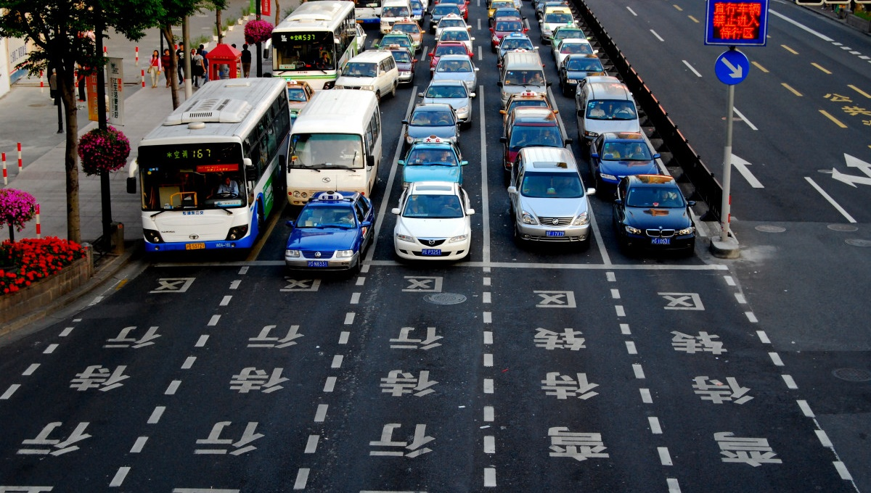
Timeline
5
DEC 22
12-16
DEC 22
9-13
JAN 23
6-10
FEB 23
4
APR 23*
START
REVIEW -1
REVIEW -II
FINAL REVIEW
LANCH DATE
Presentation Guidelines:
1) The PPT should include the following items:
Project title, guide & team members
Introduction (Minimum 2 slides)
Objective / Problem statement
Literature Review
Proposed work
Real time usage
Hardware & software requirements
Overall system architecture diagram
List out the modules & Explanation
Project timeline chart
References
Guidelines:
The PPT should include the following items:
Project title, guide & team member
Objective / Problem statement
Overall Architecture diagram and flow diagram
Complete Module split-up and Explanation
40-60% Module Implementation and Demo
References
Presentation Guidelines:
The PPT should include the following items:
Project title, guide & team members
Introduction
Existing work with limitations
Proposed work and methodology
Novelty of the project
Real time usage
Hardware & software requirements
Overall system architecture diagram.
Literature review
Module description
Module workflow explanation.
Implementation and coding.
Demo video.
Snapshot of your project.
Testing.
Result and Discussion. (Input and output)
Conclusion.

Slide 31
References
G. Dimitrakopoulos and P. Demestichas, “Intelligent transportation systems,” IEEE Vehicular Technology Magazine, vol. 5, no. 1, pp. 77–84, 2010.
K. Zaatouri and T. Ezzedine, "A Self-Adaptive Traffic Light Control System Based on YOLO," 2018 International Conference on Internet of Things, Embedded Systems and Communications (IINTEC), Hammamet, Tunisia, 2018, pp. 16-19.
A Traffic Density-Based Congestion Control Method for VANETs by Mahendrakumar Subramaniam
P. S. Geethabai, “A literature study on road accidents statistics and reasoning,” International Journal of Innovative Technology and Research, vol. 4, no. 6, pp. 4979–4984, 2016.
ASTM E2213-03, “Standard specification for telecommunications and information exchange between roadside and vehicle systems–5.9 GHz band dedicated short range communications (DSRC),” Medium Access Control MAC and Physical Layer (PHY) Specifications, vol. 4, pp. 17-18, 2003.
M. Y. B. Darus and K. A. Bakar, “Congestion control framework for disseminating safety messages in vehicular ad-hoc networks (VANETs),” International Journal of Digital Content Technology and its Applications, vol. 5, no. 2, pp. 173–180, 2011.

